Slide 1
Zoho Analytics

Slide 2
Dashboard
Tabs
Sales Overview
YTD Outlook
Goal Center
Sales Commission
Table Overview
Ad Run List
Geo Map

Slide 3
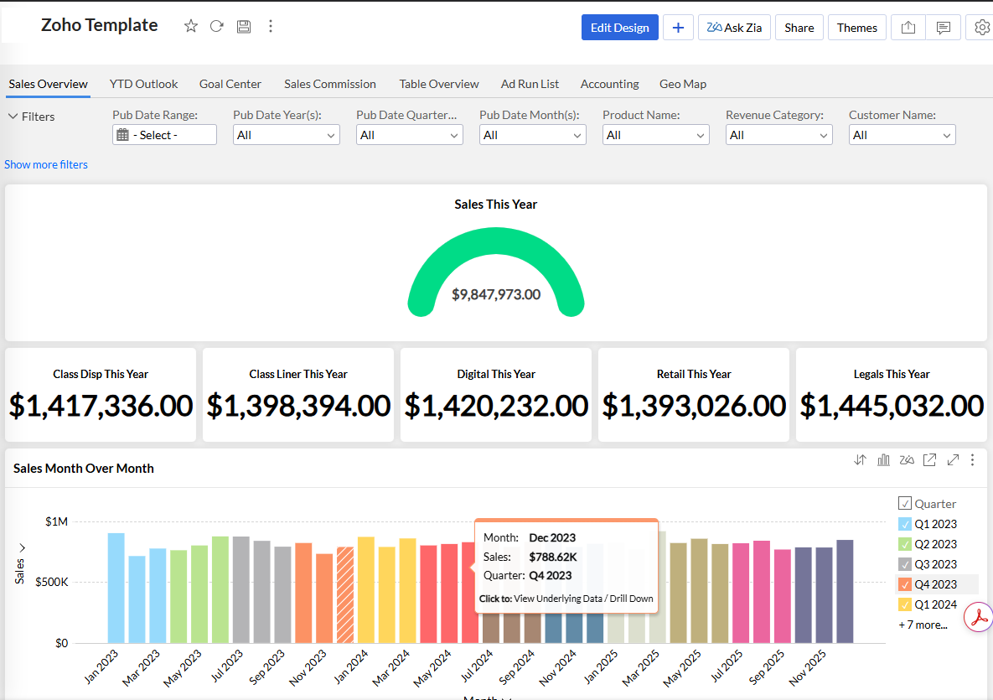

Slide 4
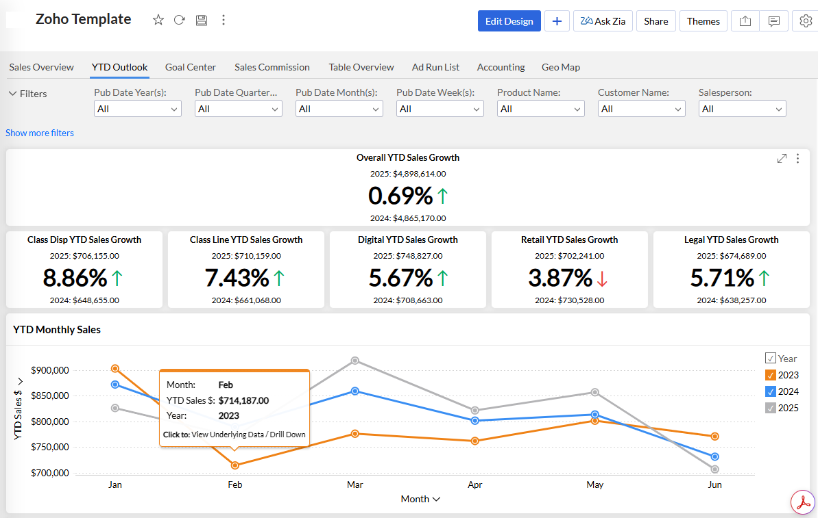

Slide 5
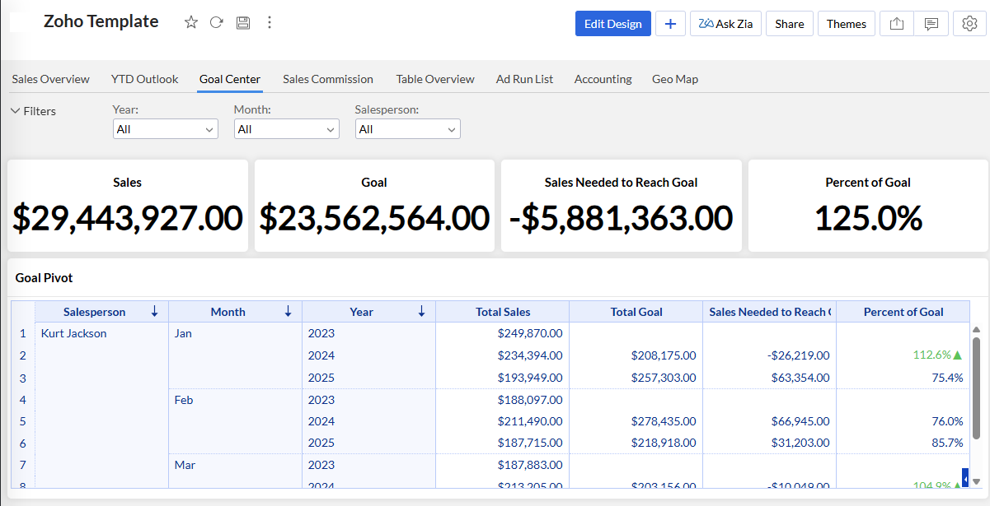

Slide 6
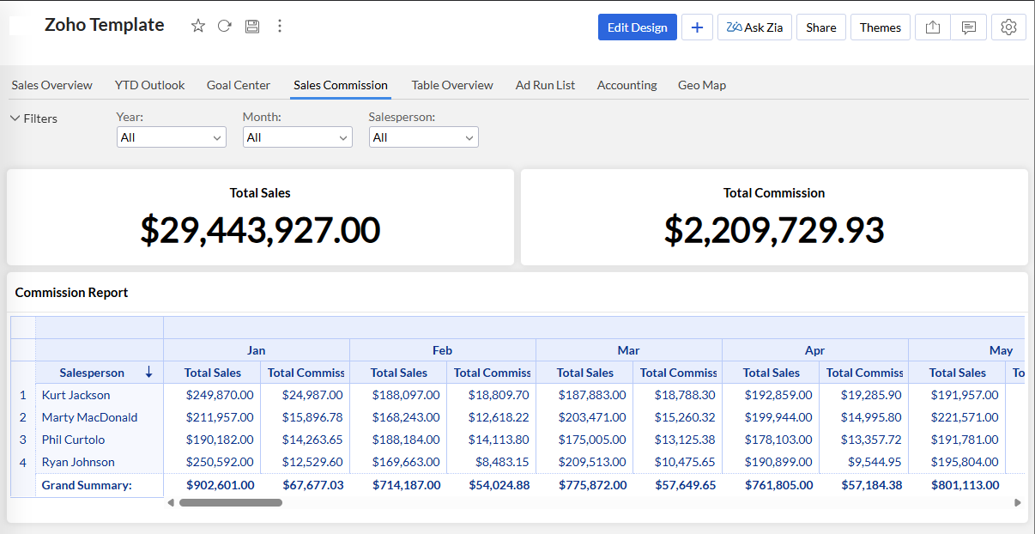

Slide 7
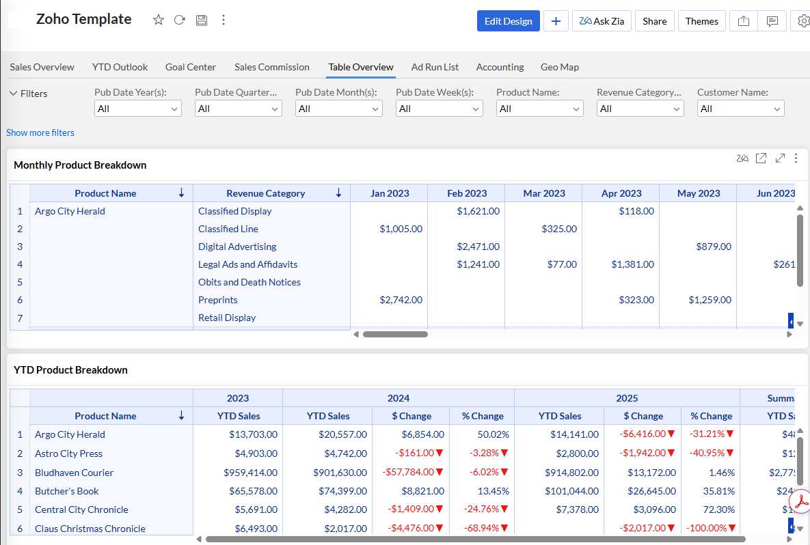

Slide 8
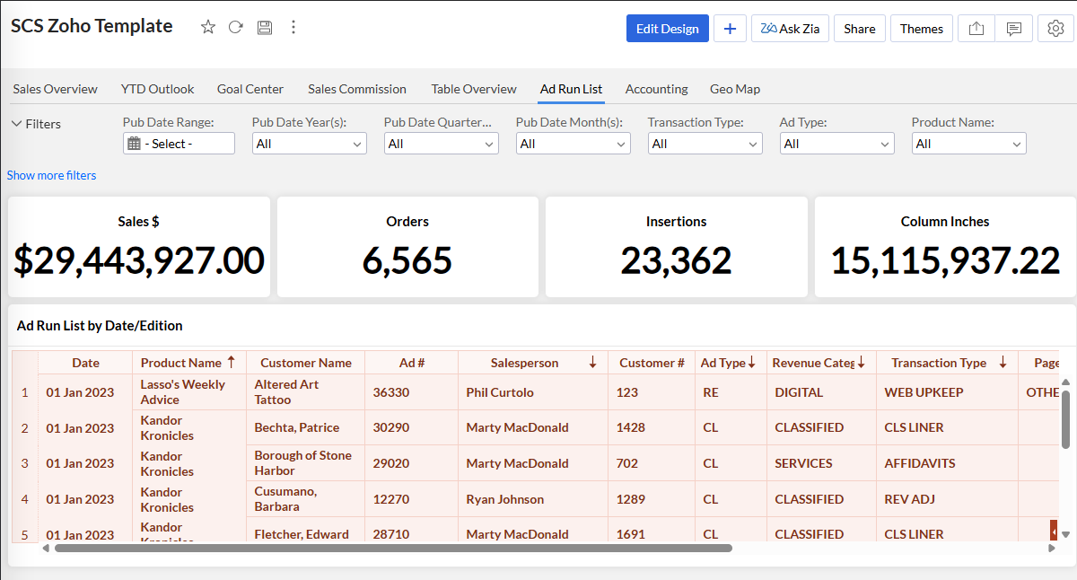

Slide 9
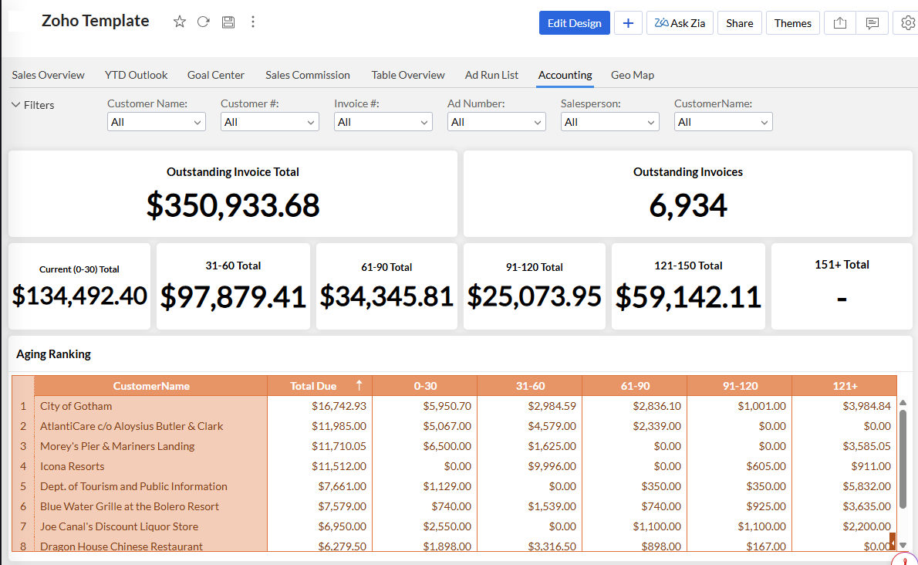

Slide 10
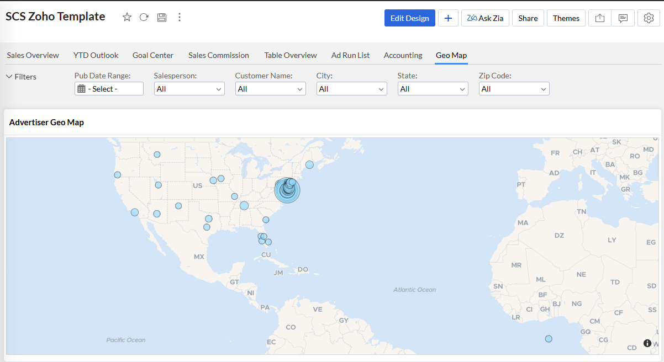

Slide 11
Queries
Queries
Monthly Sales Commission
New Customers This Month Query
Goal vs. Sales Query

Slide 12
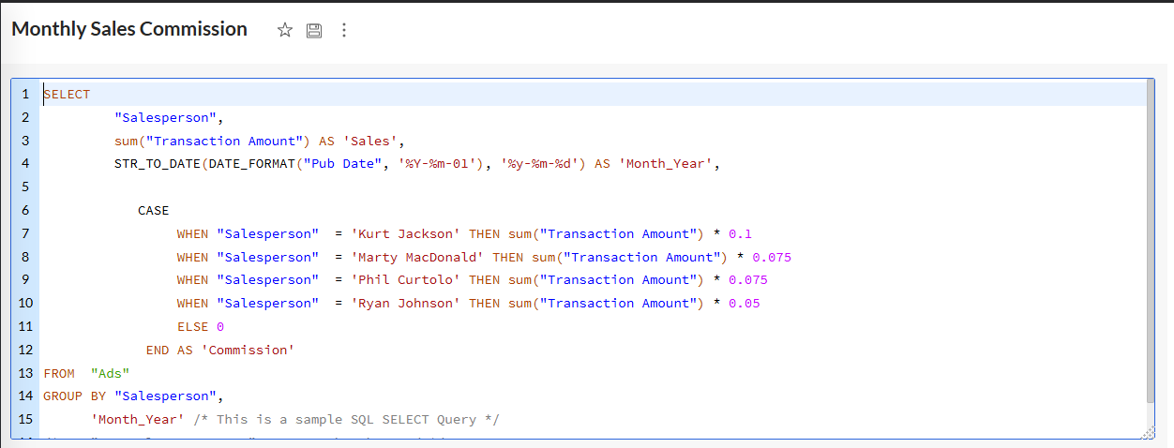

Slide 13
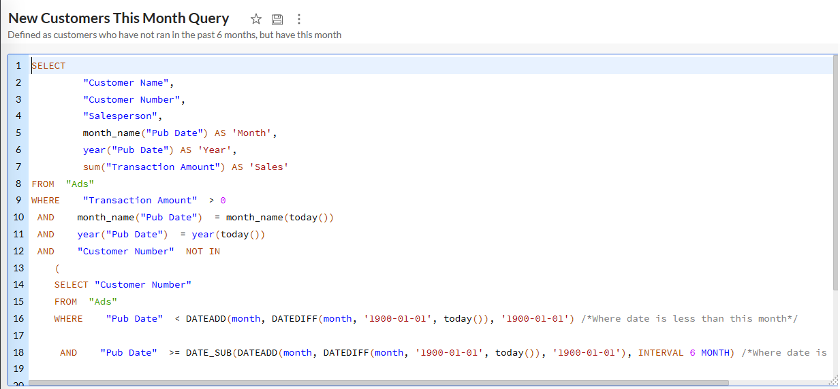

Slide 14
